Slide 1
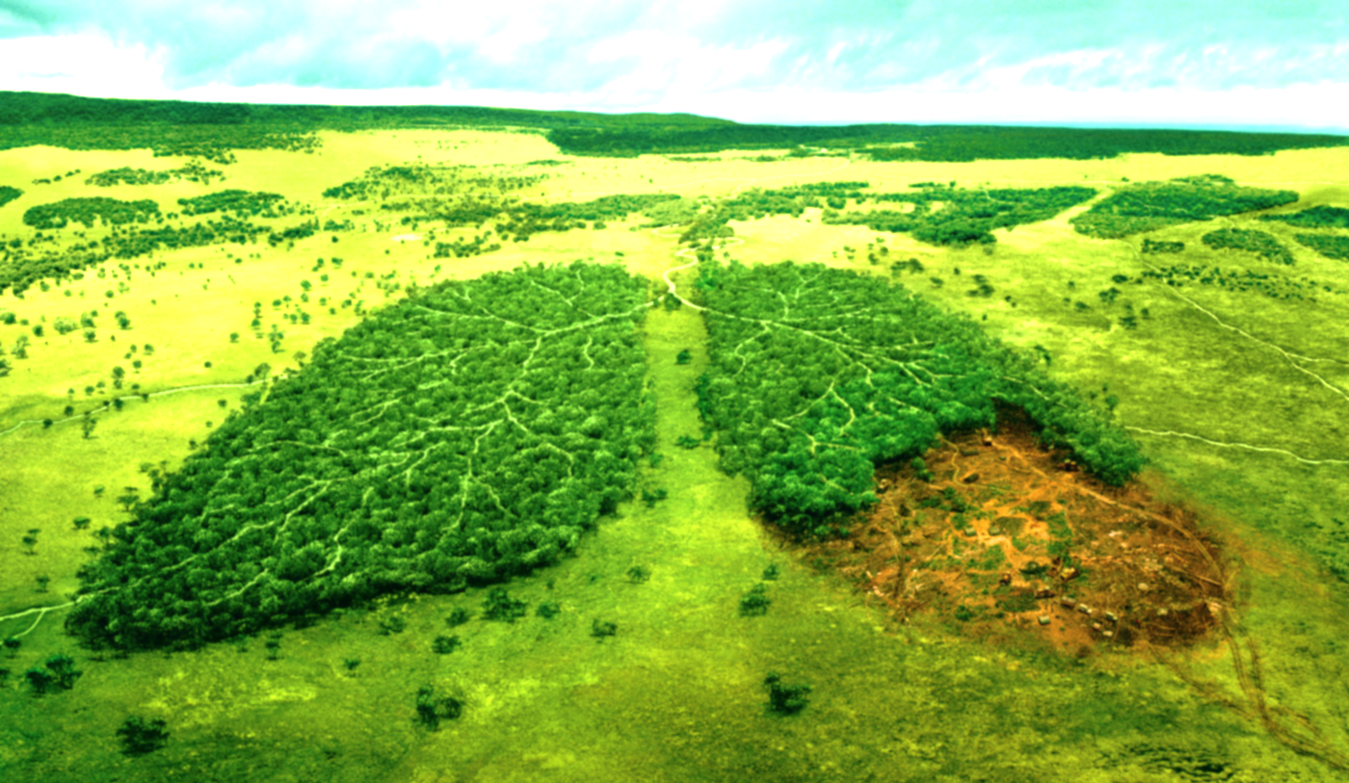

D E F O R E S T A T I O N
Eastern Zone
Registration No : 2017-298 of 2017-2018 Roll No-1637

Slide 2
OBJECTIVE
I need graphical plot using exponential smooting
01
I Need 10 year forecast value on deforestation in east india
02
I Need 10 year forecast on deforestation in east india by graphical plot
03

Slide 3
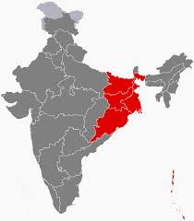
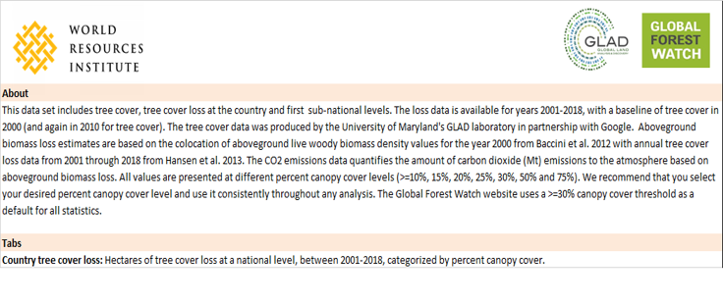
Variables : Year Andaman and Nicobar Bihar Jharkhand Odisha West Bengal
Data Description
Year | Andaman and Nicobar | Bihar | Jharkhand | Odisha | West Bengal
2001 | 9838 | 893 | 4184 | 19055 | 2496
2002 | 13145 | 254 | 529 | 24581 | 2254
2003 | 11380 | 189 | 248 | 33606 | 1215
2004 | 1469 | 455 | 1104 | 27459 | 3441
2005 | 24591 | 659 | 1807 | 22345 | 2821
2006 | 5692 | 430 | 2938 | 25840 | 4804
2007 | 5470 | 303 | 1460 | 36111 | 9576
2008 | 12115 | 552 | 2066 | 36549 | 9689
2009 | 5814 | 1618 | 5268 | 29913 | 5644
2010 | 5370 | 726 | 2341 | 14729 | 12632
2011 | 683 | 401 | 1168 | 34730 | 5903
2012 | 4799 | 640 | 2019 | 23662 | 7722
2013 | 3312 | 91 | 1065 | 34270 | 2124
2014 | 9296 | 94 | 1163 | 47870 | 4223
2015 | 504 | 16 | 705 | 24709 | 992
2016 | 1093 | 50 | 1166 | 53308 | 1725
2017 | 1965 | 235 | 2309 | 64756 | 3146
2018 | 733 | 54 | 1178 | 62966 | 1900

Slide 4
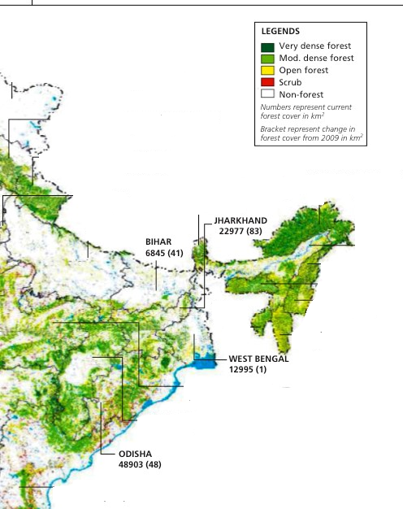
Introduction : Deforestation
Forest cover 31% of the land area on our planet.
They produce vital oxygen and provide homes for people and wildlife.
Many of the world’s most threatened endangered animals live in these forest.
1.8 billion people rely on benefits forests offer including food, fresh water ,medicine etc.
What is deforestation?
Deforestation, clearance, clearcutting or clearing is the removal of a forest or stand of trees from land which is then converted to a non-forest use. Deforestation can involve conversion of forest land to farms, ranches, or urban use. The most concentrated deforestation occurs in tropical rainforests. About 31% of Earth's land surface is covered by forests.

Slide 5
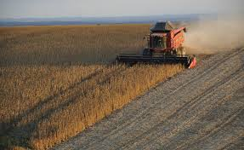

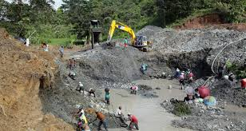
Cause :
Agricultural activities:
In 2000 the United Nations Food and Agriculture Organization (FAO) found that "the role of population dynamics in a local setting may vary from decisive to negligible", and that deforestation can result from "a combination of population pressure and stagnating economic, social and technological conditions“.
Logging:
Subsistence farming is responsible for 48% of deforestation; commercial agriculture is responsible for 32%; logging is responsible for 14%, and fuel wood removals make up 5%.
Mining:
Oil and coal mining required considerable amount of forest land .Apart from this, road and highways have to be built to make way for truck and other equipment.
Urbanization.
Fire.
Etc.

Slide 6
Why exponential smoothing?
Other all method of forecast, it is also include weight with previous data. But it increase exponentially.
My data is univariate Time Series, for that exponential smoothing is better for me then other methods.
Exponential Smoothing is better for systematic trend, which is also familiar with my data.
For view the future trend, Exponential Smoothing is Good method.

Slide 7
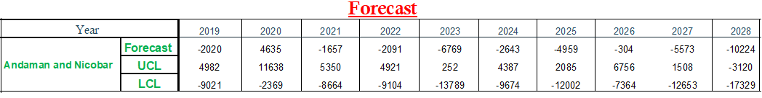
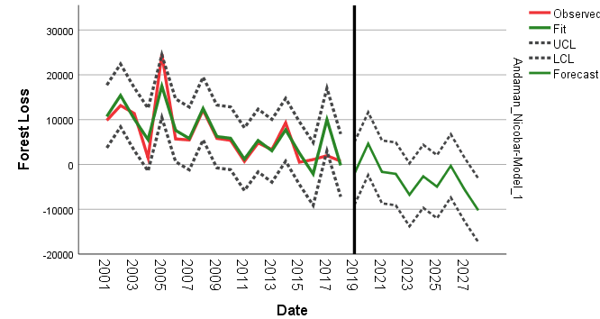
ANDAMAN AND NICOBAR
Analysis and Plot
10 Year forecast value chart:
Plot:
By this 10 year graphical forecast in Andaman and Nicobar ,we said deforestation should be decrease .

Slide 8
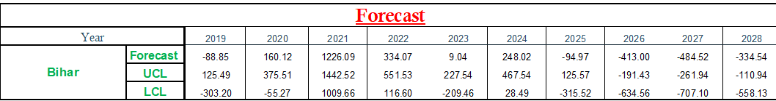
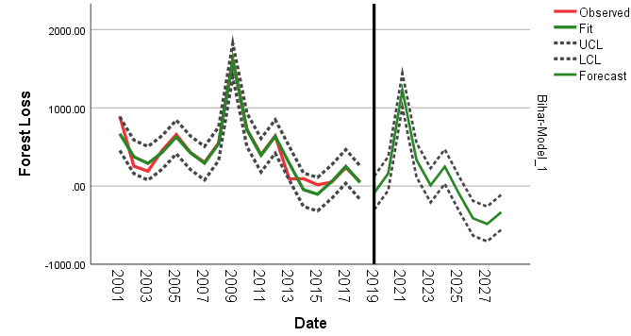
BIHAR
10 Year forecast value chart:
Plot:
By this 10 year graphical forecast in Bihar, we said deforestation should be increase or same as previous 18 years.

Slide 9
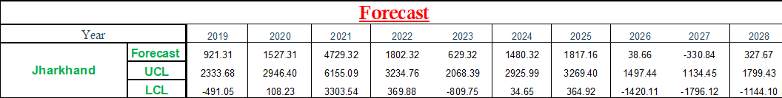
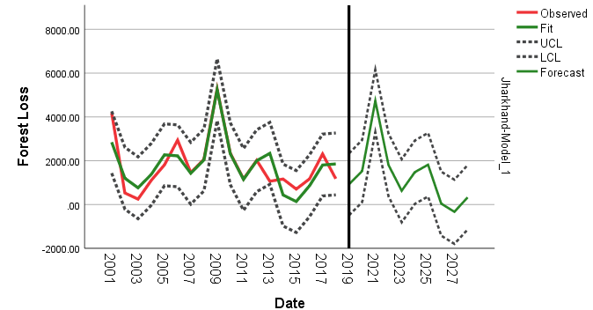
JHARKHAND
10 Year forecast value chart:
Plot:
By this 10 year graphical forecast in Jharkhand ,we said deforestation should be increase or same as previous 18 years.

Slide 10
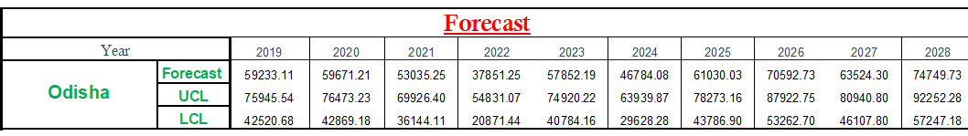
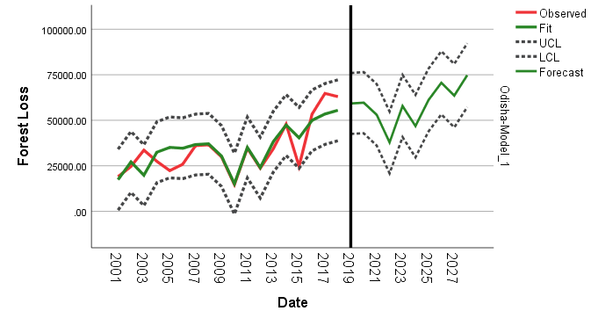
ODISHA
10 Year forecast value chart:
Plot:
By this 10 year graphical forecast in Odisha,we said deforestation increase .

Slide 11
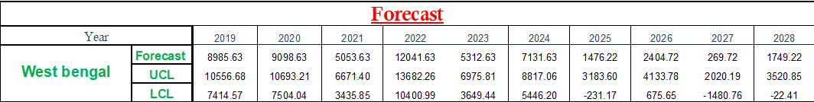
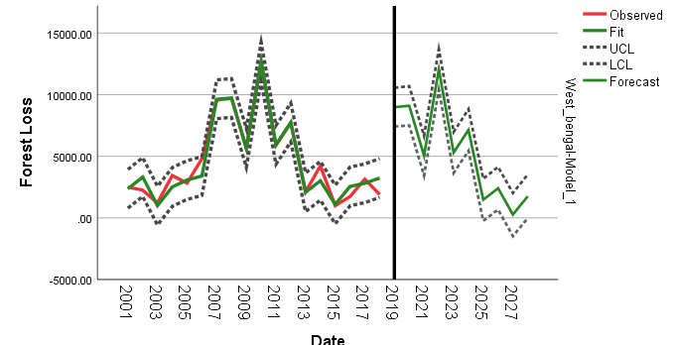
WEST BENGAL
10 Year forecast value chart:
Plot:
By this 10 year graphical forecast in West Bengal, we said deforestation should be increase or same as previous 18 years .

Slide 12
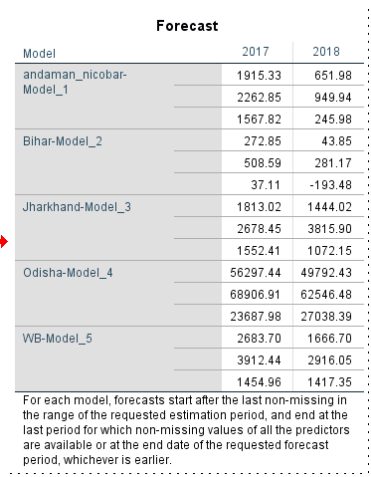
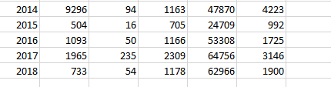
ANALYSIS CONCLUSION
Collect data from 2001 to 2016 and forecast 2 years deforestation .So, here we see the value interval of 2 years deforestation nearly same as the last two year my given data . So from this statement we say my forecast value and graphical plot should be right.
By the plot of Andaman and Nicobar we say that 10 year deforestation should be decrease.
By the plot of Bihar we say that 10 year deforestation should be increase or same as previous 18 years.
By the plot of Jharkhand we say that 10 year deforestation should be increase or same as previous 18 years.
By the plot of Odisha we say that 10 year deforestation should be increase .
By the plot of West Bengal we say that 10 year deforestation should be increase or same as previous 18 years .

Slide 13
Effect
Project conclusion
Environmental effects:
Atmospheric
Hydrological
Soil
Biodiversity
Health Effects:
Public health context
Others

Slide 14
REFERENCE
Collect My Data From Website : www.globalforestwatch.org
Data read and understanding : https://www.livescience.com
Data description : https://en.wikipedia.org/wiki/Deforestation
Follow book : Applied Statistics ; Gupta and Kapoor

Slide 15
Thank You

